Slide 1
ELECTRICAL SCIENCE-1
(15B11EC111)
Unit-2
DC Circuit Analysis
Lecture-3
Dr. Abhishek Kashyap
Assistant Professor (Senior Grade, JIIT Noida)

Slide 2
Topics to be Discussed
Source Transformation
Numerical
Methods of Analysis of Resistive Circuits
Node Voltage Method
Mesh Current Method
References

Slide 3
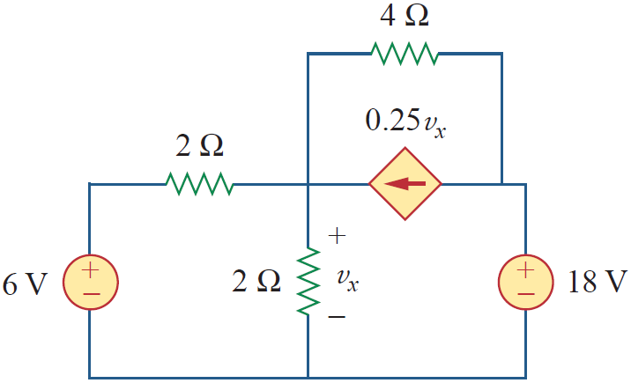
Problem
Find V_{x} in Fig. using source transformation

Slide 4
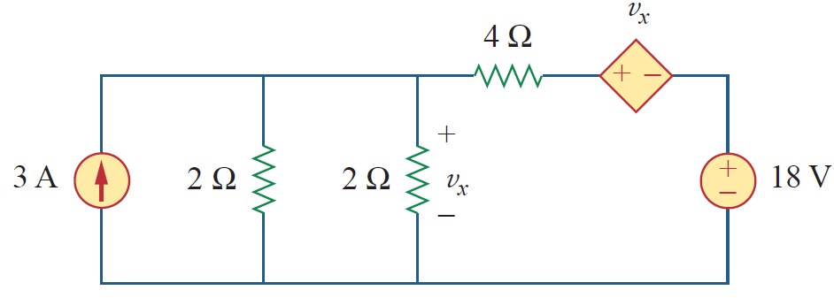
Problem - Solution
The circuit in Fig. involves a voltage-controlled dependent current source.
We transform this dependent current source as well as the 6-V independent voltage source as shown in Figure below.
The 18-V voltage source is not transformed because it is not connected in series with any resistor.

Slide 5
Problem - Solution
The two 2-Ω resistors in parallel combine to give a 1-Ω resistor, which is in parallel with the 3-A current source.

Slide 6
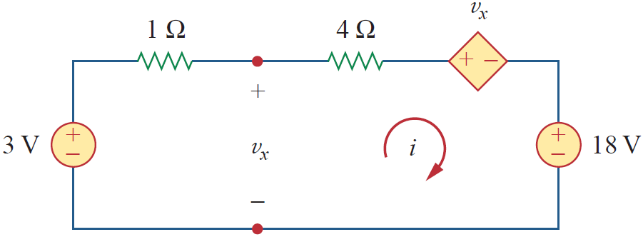
Problem - Solution
The current source is transformed to a voltage source as shown in Fig.

Slide 7



Problem - Solution
Applying KVL around the loop gives
Applying KVL to the loop containing only the 3-V voltage source, the 1-Ω resistor, and v_{x} yields
By using above equations, we get
Thus,

Slide 8
Methods of Analysis of Resistive Circuits
Method for small circuits: write and solve a set of equations. Obtain equations using Kirchhoff’s current and voltage laws. The constitutive equations of the circuit elements, such as Ohm’s law, provide the remaining equations. The unknown variables are element currents and voltages.

Slide 9
Methods of Analysis of Resistive Circuits
For moderate-sized/Large-sized circuits, above method provides quite large set of equations.
So for such type of circuits, we consider two methods for writing a smaller set of simultaneous equations:
The node voltage method.
The mesh current method.

Slide 10
Node Voltage Method
The node voltage method uses a new type of variable called the node voltage.
The “node voltage equations” or, more simply, the “node equations,” are a set of simultaneous equations that represent a given electric circuit.
The unknown variables of the node voltage equations are the node voltages.
After solving the node voltage equations, we determine the values of the element currents and voltages from the values of the node voltages.

Slide 11
Node Voltage Method
It’s easier to write node voltage equations for some types of circuit than for others.
Starting with the easiest case, we will learn how to write node voltage equations for circuits that consist of:
Resistors and independent current sources.
Resistors and independent current and voltage sources.
Resistors and independent and dependent voltage and current sources.

Slide 12
Mesh Current Method
The mesh current method uses a new type of variable called the mesh current.
The “mesh current equations” or, more simply, the “mesh equations,” are a set of simultaneous equations that represent a given electric circuit.
The unknown variables of the mesh current equations are the mesh currents.
After solving the mesh current equations, we determine the values of the element currents and voltages from the values of the mesh currents.

Slide 13
Mesh Current Method
It’s easier to write mesh current equations for some types of circuit than for others.
Starting with the easiest case, we will learn how to write mesh current equations for circuits that consist of:
Resistors and independent voltage sources.
Resistors and independent current and voltage sources.
Resistors and independent and dependent voltage and current sources.

Slide 14
References
R.C. Dorf and James A. Svoboda, “Introduction to Electric Circuits”, 9th ed, John Wiley & Sons, 2013.
D.C. Kulshreshtha, Basic Electrical Engineering, Revised 1st ed, Tata Mc Graw Hill, 2017.
V. K.Mehta, Rohit Mehta, Basic Electrical Engineering, 6th ed, S. Chand Publishing, 2012.

